Slide 1

3

Slide 3
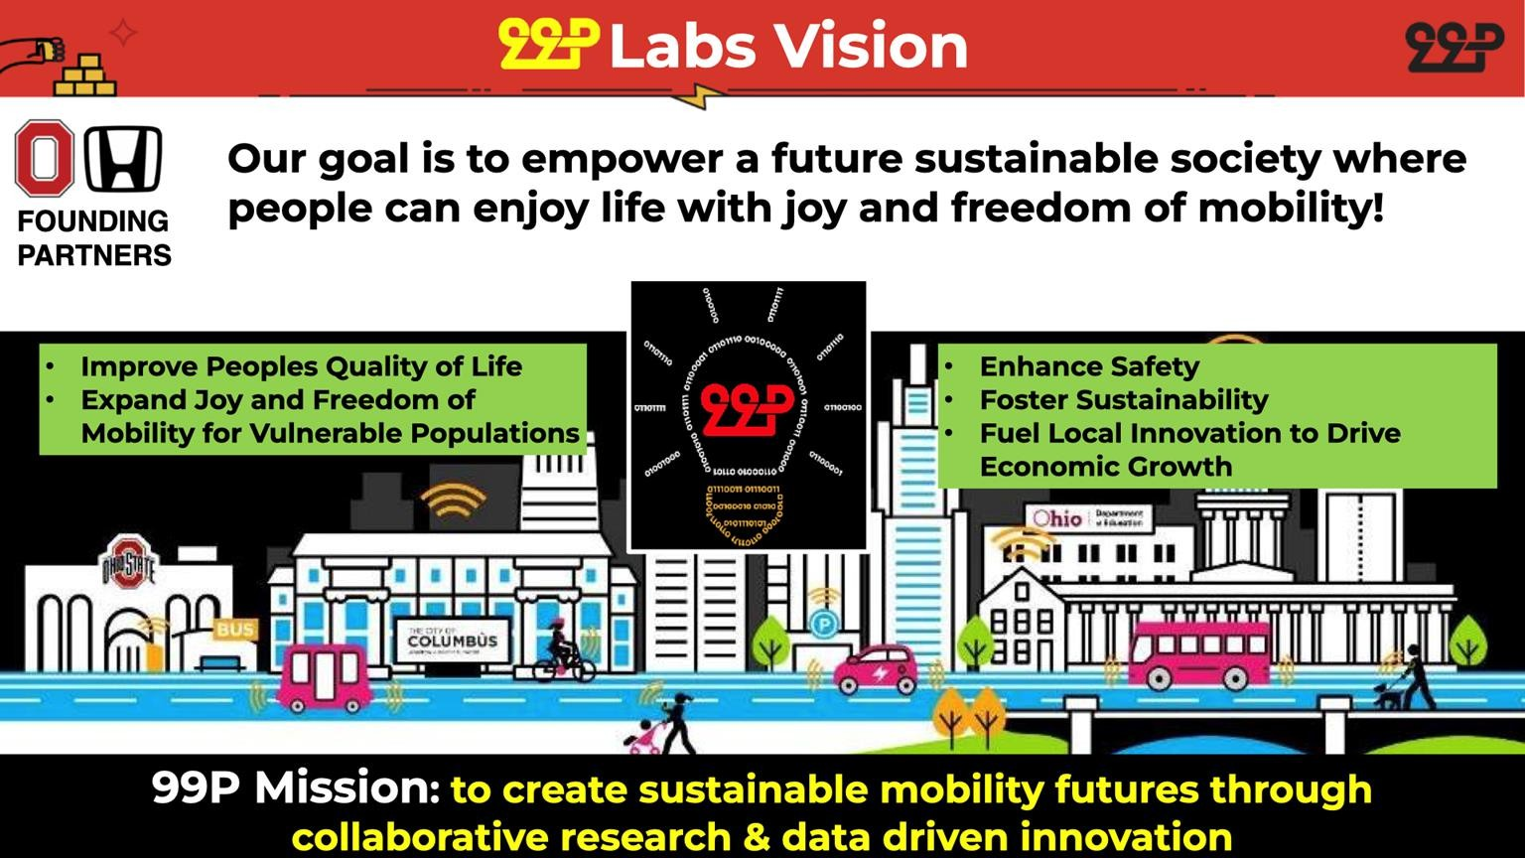

Slide 4
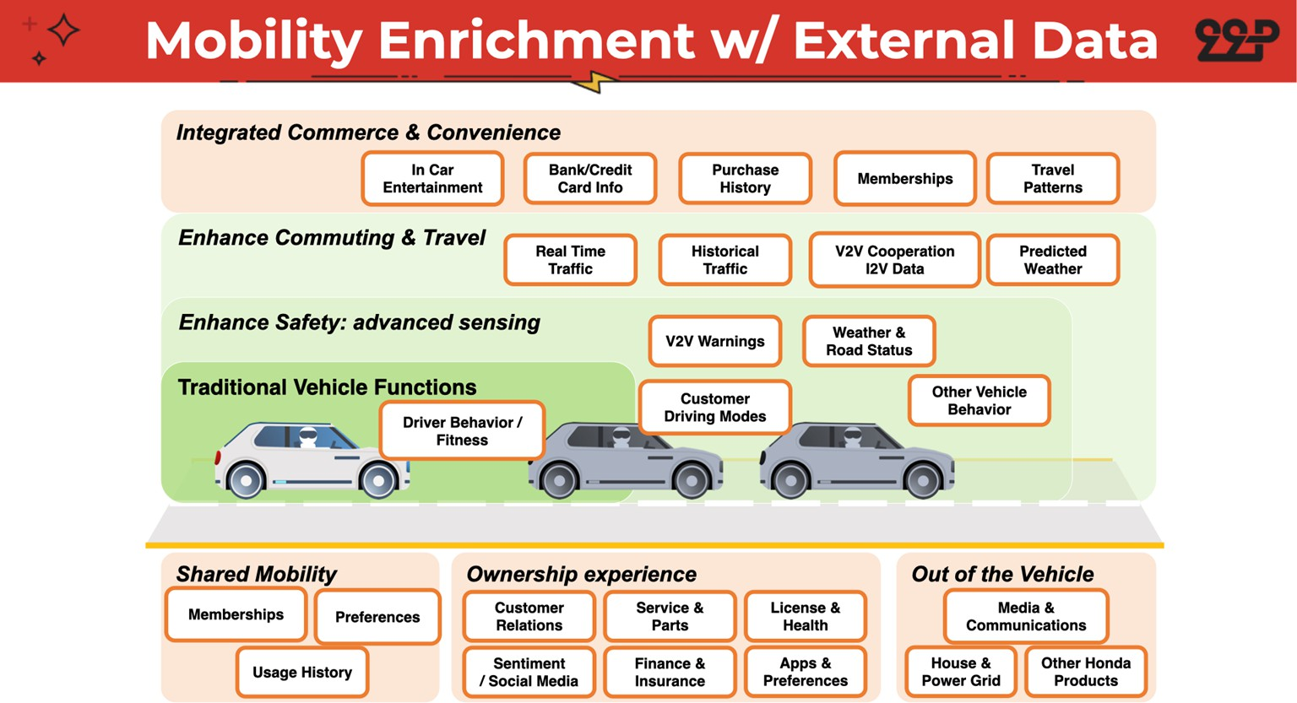

Slide 5
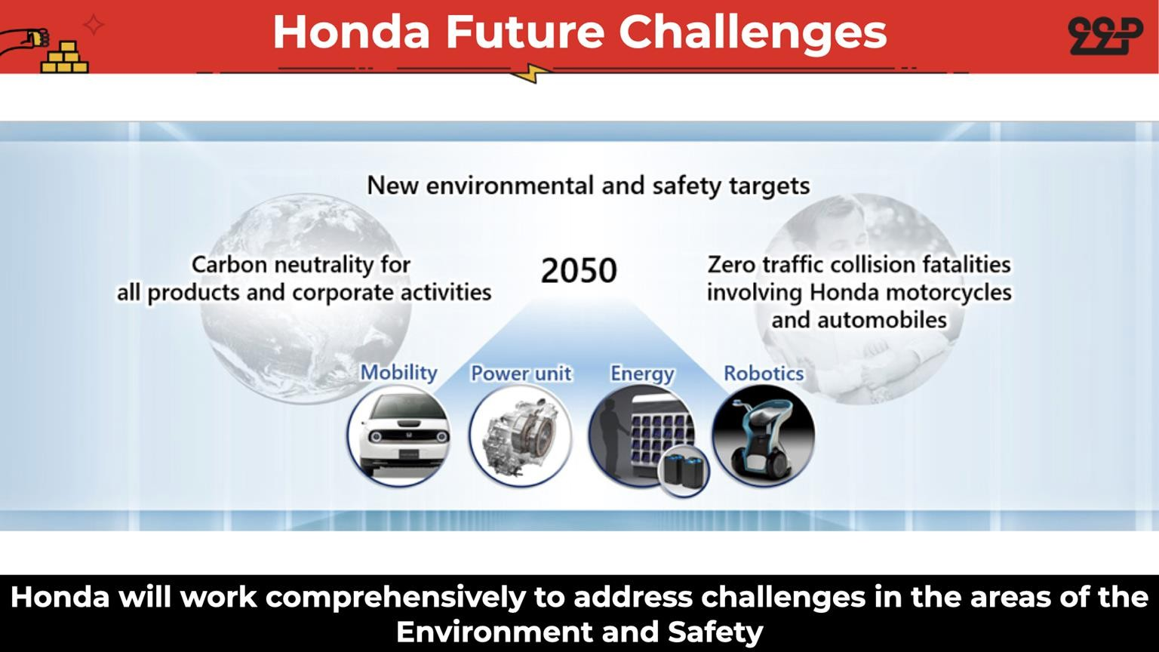

Slide 6
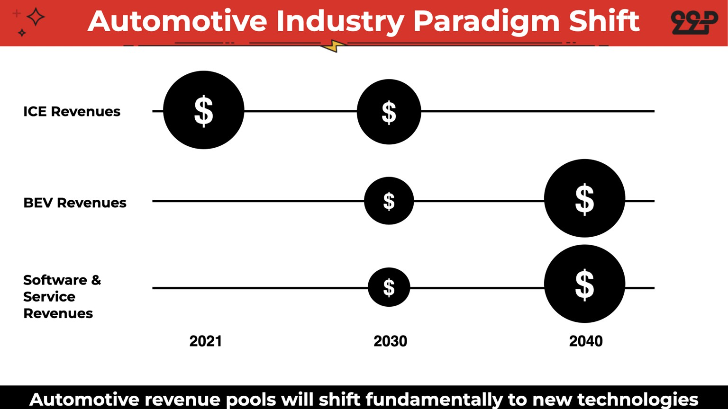

Slide 7
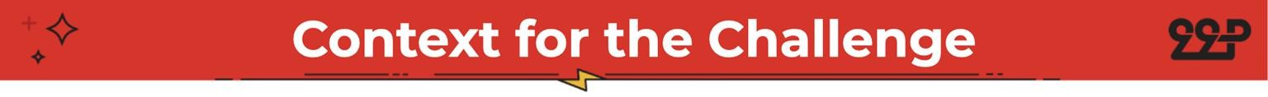
In a rapidly evolving automotive landscape, Battery Electric Vehicles (BEVs) are gaining prominence due to their cost savings, environmental benefits, and reduced maintenance. However, as consumer preferences and values continue to diversify, companies face an increasingly complex challenge in distinguishing their offerings. So how can a hypothetical BEV company create a value proposition and entry strategy for this market?

Slide 8
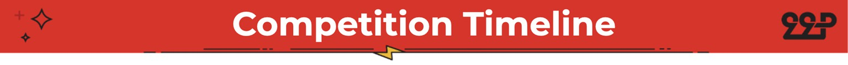
Monday | 10/30/23 | Competition Announced and Signup Opened
Monday | 11/06/23 | Competition Kicks-off
Monday | 11/20/23 | Submissions Due
Wednesday | 11/29/23 | Top 3 Selected
Friday | 12/01/23 | Top 3 Presentations
Friday | 12/01/23 | 1st, 2nd, and 3rd Place Announced
November 1st week : Data Analytics Club Office Hours
November 2nd week : Honda Office Hours

Slide 9
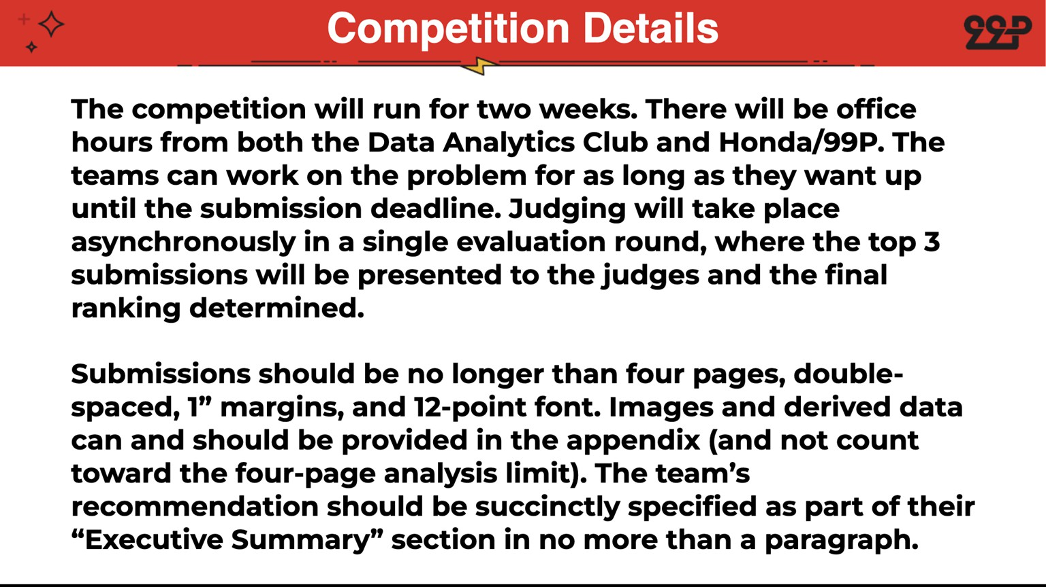
ten
ten

Slide 10
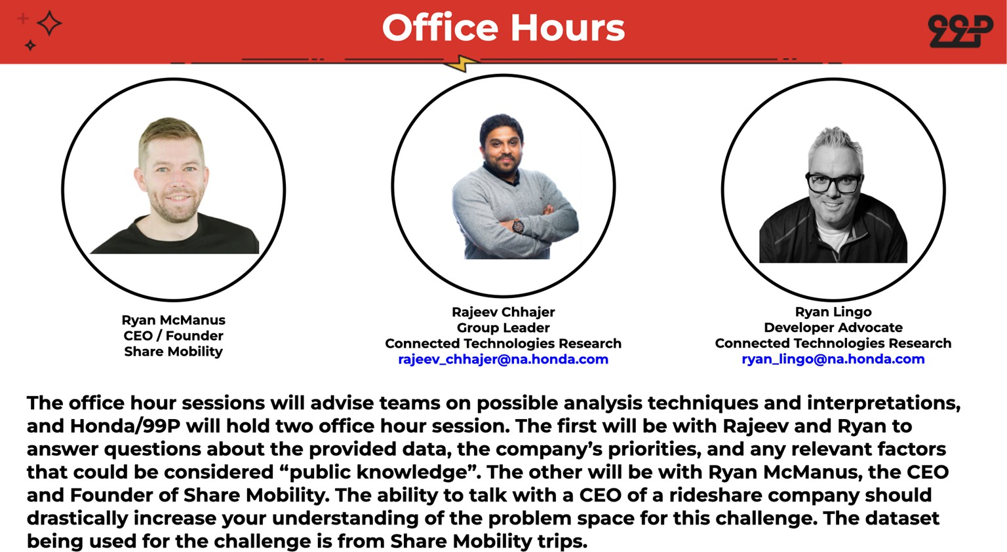

Rajeev Chhajer
Chief Engineer
Software-defined Mobility
rajeev_chhajer@honda-ri.com
Ryan Lingo
Developer Advocate
Software-defined Mobility
ryan_lingo@honda-ri.com
The office hour session is where Honda/99P Labs will advise teams on possible analysis techniques and high level interpretations. Ryan will be available to answer any questions about possible use cases, the company’s priorities, or any relevant factors that could be considered “public knowledge” and could help participants in the competition.

Slide 11


Slide 12
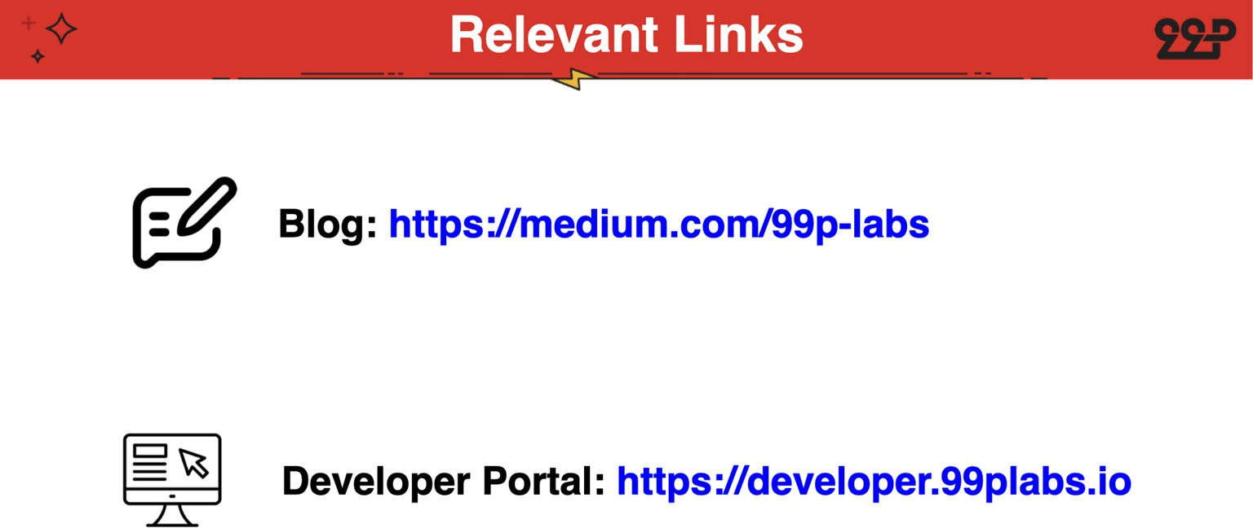

Slide 13
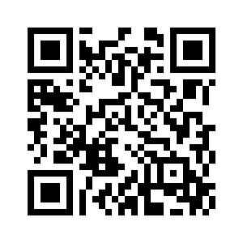

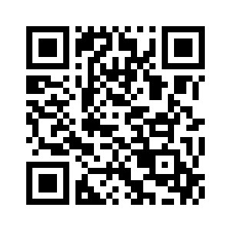
THANK YOU!
Team Sign-up
DA Discord Server
DA Membership Link

Slide 15
